Slide 1
ER diagram

Slide 2
14-7 DATABASE DESIGN
The design of any database is a lengthy and involved task that can only be done through a step-by-step process. The first step normally involves interviewing potential users of the database. The second step is to build an entity-relationship model (ERM) that defines the entities, the attributes of those entities and the relationship between those entities.
14.<number>

Slide 3
Entity-relationship models (ERM)
In this step, the database designer creates an entity-relationship (E-R) diagram to show the entities for which information needs to be stored and the relationship between those entities. E-R diagrams uses several geometric shapes, but we use only a few of them here:
❑ Rectangles represent entity sets
❑ Ellipses represent attributes
❑ Diamonds represent relationship sets
Lines link attributes to entity sets and link entity sets to
relationships sets
14.<number>

Slide 4
The Pieces
Objects
  Entity (including weak entities)
  Attribute
  Relationship
“Structural” Constraints
  Cardinality
  Participation

Slide 5
Entities
Entity – basic object of the E-R model
  Represents a “thing” with an independent existence
  Can exist physically or conceptually
    a professor, a student, a course
Entity type or Entity set – used to define a set of entities with the same properties.

Slide 6
Entity and Entity Types
Name
Entity Type
Number
Topic
Course
Number: 1123
Name: Computer Programming 2
Topic: Computer Programming
Entity

Slide 7
Weak Entity
An entity type should have a key attribute which uniquely identifies each entity in the entity set, but there exists some entity type for which key attribute can’t be defined. These are called Weak Entity type.
The entity sets which do not have sufficient attributes to form a primary key are known as weak entity sets and the entity sets which have a primary key are known as strong entity sets.
As the weak entities do not have any primary key, they cannot be identified on their own, so they depend on some other entity (known as owner entity).
Partial Keys are set of attributes with the help of which the tuples of the weak entities can be distinguished and identified.

Slide 8
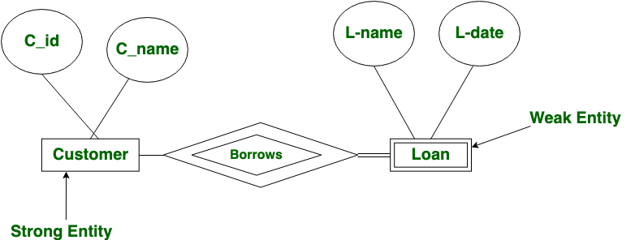
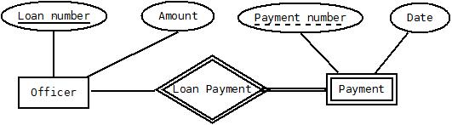
In the below ER Diagram, ‘Payment’ is the weak entity. ‘Loan Payment’ is the identifying relationship and ‘Payment Number’ is the partial key. Primary Key of the officer along with the partial key of the Payment would be used to identify the records.

Slide 9
Attributes
Each entity has a set of associated properties that describes the entity. These properties are known as attributes.
Attributes can be:
  Simple or Composite
  Single or Multi-valued
  Stored or Derived
  NULL

Slide 10
Attributes (cont’d)
Simple
Professor
Start Date
First
Composite
Professor
Name
Last

Slide 11
Attributes (cont’d)
Single
Professor
Employee ID#
Multi-Valued
Professor
Email

Slide 12
Stored and derived attributes
An attribute, which cannot be derived from other attribute, is known as stored attribute. For example person’s date of birth.
The stored attribute are such attributes which are already stored in the database and from which the value of another attribute is derived is called stored attribute.
For example age of a person can be calculated from person’s date of birth and present date. Difference between these two dates gives the value of age. In this case, date of birth is a stored attribute and age of the person is the derived attribute

Slide 13
Primary Keys
Professor
Employee ID
Employee ID is the primary key
Primary keys must be unique for the entity

Slide 14
Relationships
Defines a set of associations between various entities
Can we have attributes to define them
Yes, but they are limited by:
  Participation
  Cardinality Ratio

Slide 15
Relationships (cont’d)
Section
part of
Course

Slide 16
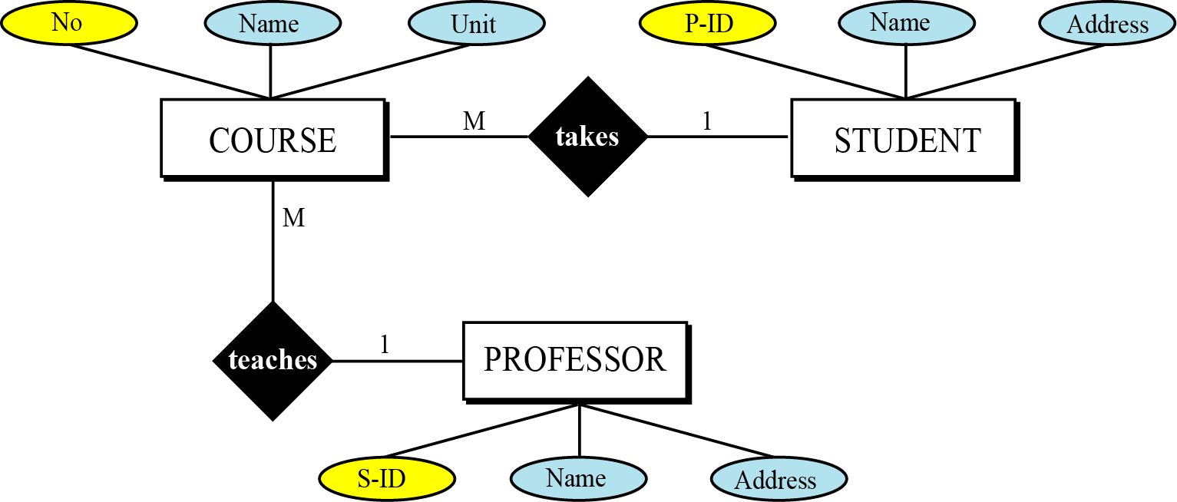
Example 14.1
Figure 14.16 shows a very simple E-R diagram with three entity sets, their attributes and the relationship between the entity sets.
Figure 14.16 Entities, attributes and relationships in an E-R diagram
14.<number>

Slide 17
From E-R diagrams to relations
After the E-R diagram has been finalized, relations (tables) in the relational database can be created.
Relations for entity sets
For each entity set in the E-R diagram, we create a relation (table) in which there are n columns related to the n attributes defined for that set.
14.<number>

Slide 18
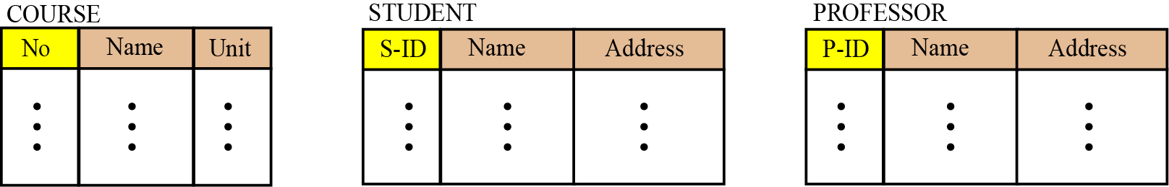
Example 14.2
We can have three relations (tables), one for each entity set defined in Figure 14.16, as shown in Figure 14.17.
Figure 14.17 Relations for entity set in Figure 14.16
14.<number>

Slide 19
Relations for relationship sets
For each relationship set in the E-R diagram, we create a relation (table). This relation has one column for the key of each entity set involved in this relationship and also one column for each attribute of the relationship itself if at all the relationship has attributes (not in our case).
14.<number>

Slide 20
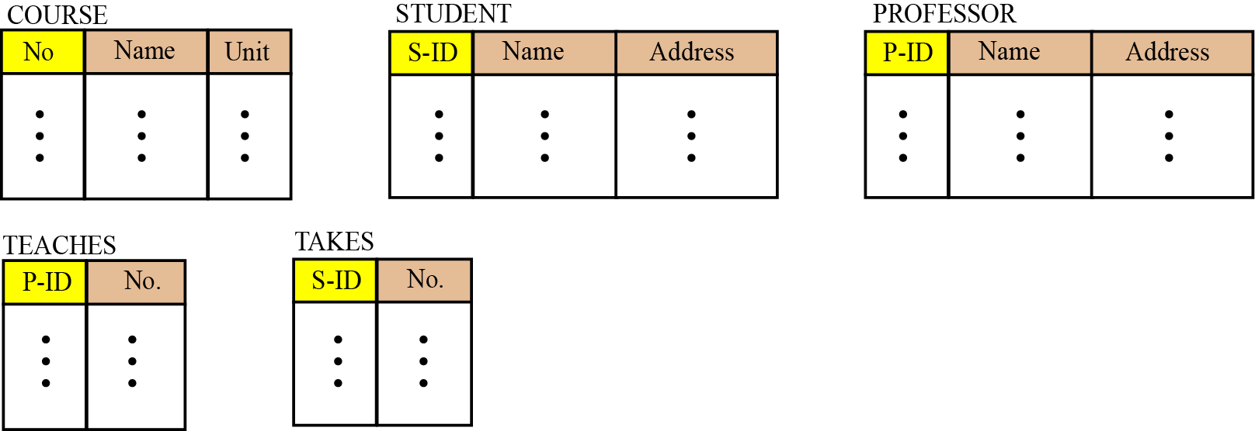
Example 14.3
There are two relationship sets in Figure 14.16, teaches and takes, each connected to two entity sets. The relations for these relationship sets are added to the previous relations for the entity set and shown in Figure 14.18.
Figure 14.18 Relations for E-R diagram in Figure 14.16
14.<number>

